Slide 1
PENINSULA BIBLE CHURCH RECOVERY MINISTRY
CARRYING LOVE AND HOPE TO OTHERS BY FIRST ACKNOWLEDGING THE LOVE AND HOPE WE HAVE RECEIVED
https://www.pbc.org/Recovery

Slide 2

Peninsula Bible Church Recovery Ministry
We seek to provide a place to help develop a foundation for your life by using the 12-step recovery principles and biblical teaching as a tool for developing an intimate relationship with God, thus allowing us to depend upon His power and faithfulness.

Slide 3
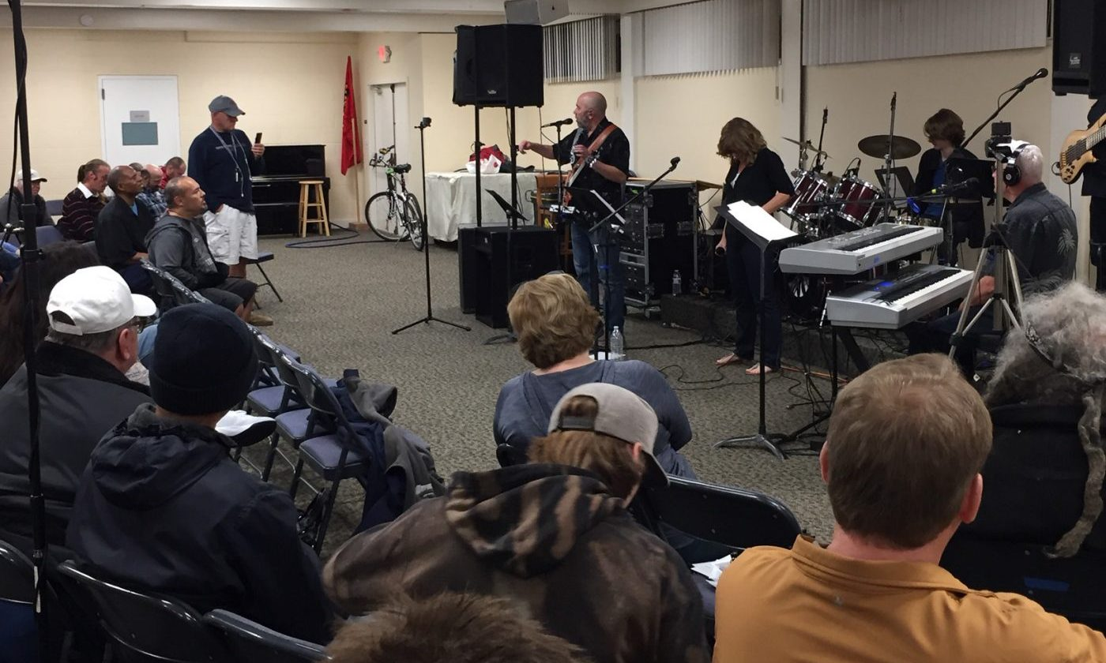


R&R
PBC’s R&R (Recovery and Renewal) celebration is the weekly outreach of our Recovery Community.
We meet In the Fellowship Hall at Peninsula Bible Church, 3505 Middlefield Rd Palo Alto, CA 94306,
every Friday evening 7-9:00pm (including holidays!) Experience a time of praise, worship, teaching, and community. Dinner is provided. Come and join us in the celebration at R&R!
PLEASE NOTE: To watch current and previous messages online go to the Recovery Playlist on the PBC YouTube Channel.

Slide 4
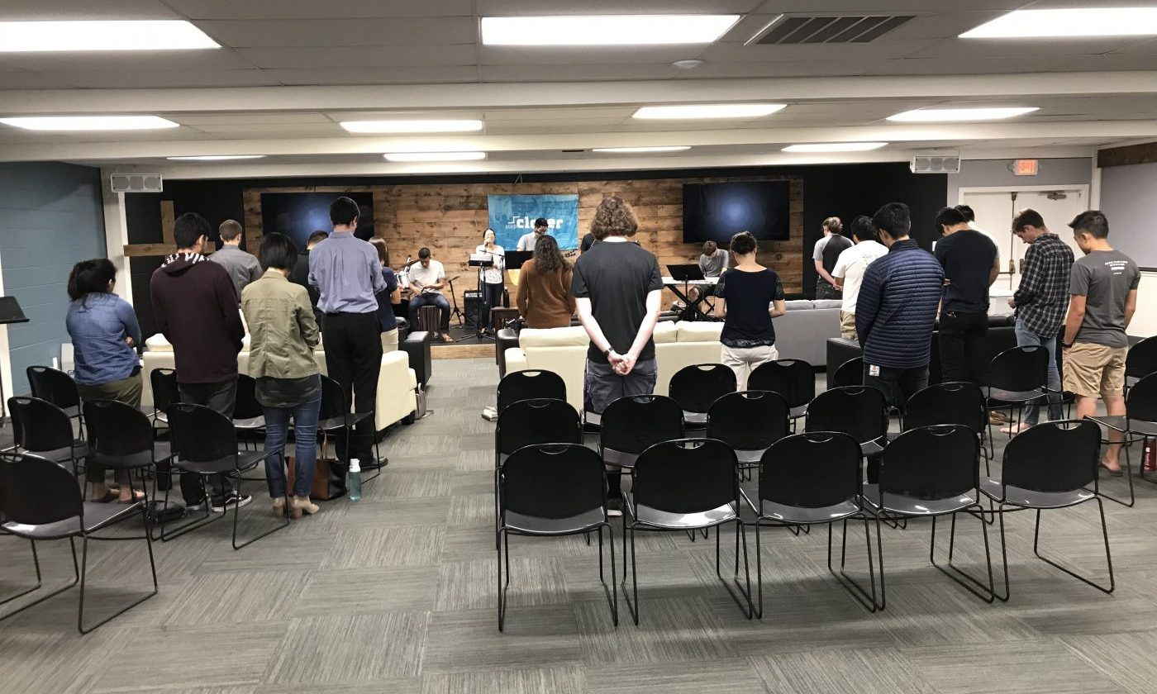


Step Closer
Step Closer is a joyful Sunday morning gathering celebrating our recovery, freedom, and new life in Christ! We worship through singing, prayer, and teaching, and we experience a rich sense of community through fellowship and sharing. We meet on Sunday mornings from 9:00 – 10:30 AM in the Upper Room,
at Peninsula Bible Church 3505 Middlefield Rd Palo Alto, CA 94306,
PLEASE NOTE: To watch current and previous messages online go to the Recovery Playlist on the PBC YouTube Channel.

Slide 5
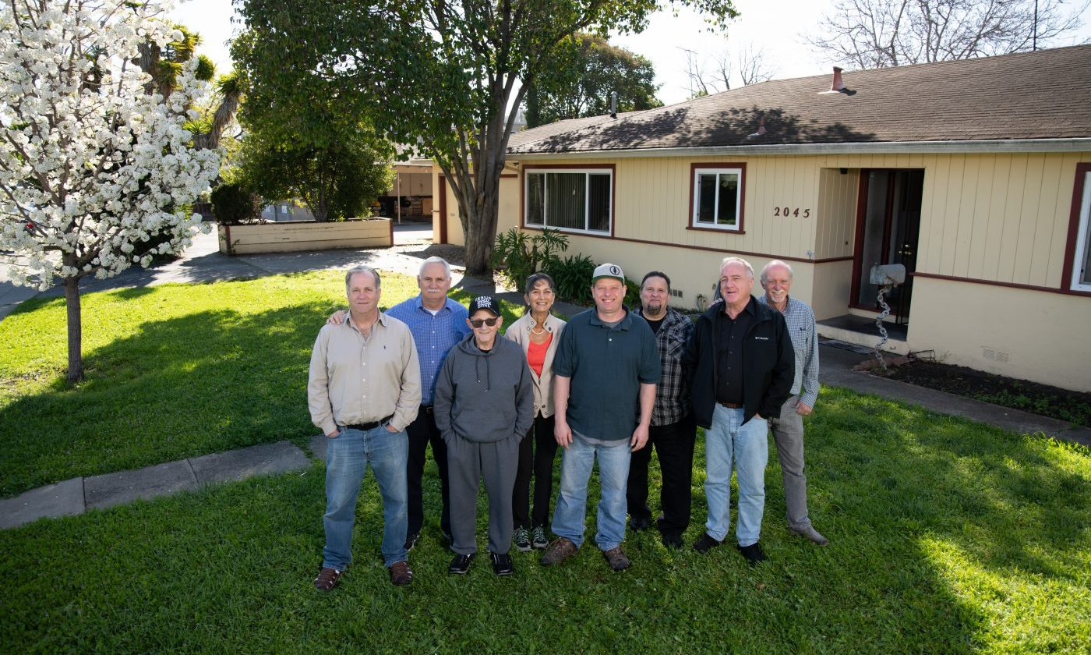


OBH
Our Brother’s Home (OBH) is a non-profit Christian organization affiliated with the Recovery Ministry at Peninsula Bible Church in Palo Alto. OBH, which first opened in 2009, provides transitional housing for up to two years for men who have been struggling with drugs, alcohol, and a variety of other issues.
info@ourbrothershome.org
PO Box 1581
Mountain View, CA 94042

Slide 6
“Praise be to God and Father of our Lord Jesus Christ, the Father of compassion and the God of all comfort, who comforts us in all our troubles, so that we can comfort those in any trouble with the comfort we ourselves have received from God.”
2 Corinthians 1:3-4

