Slide 1


The Heart of Pride
Notes:
Please edit this page to include your name, pronouns and title

Slide 2



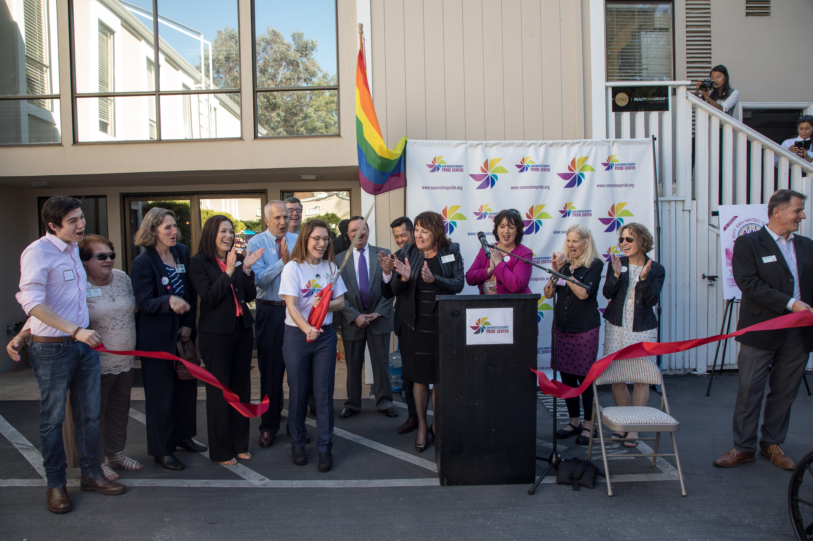


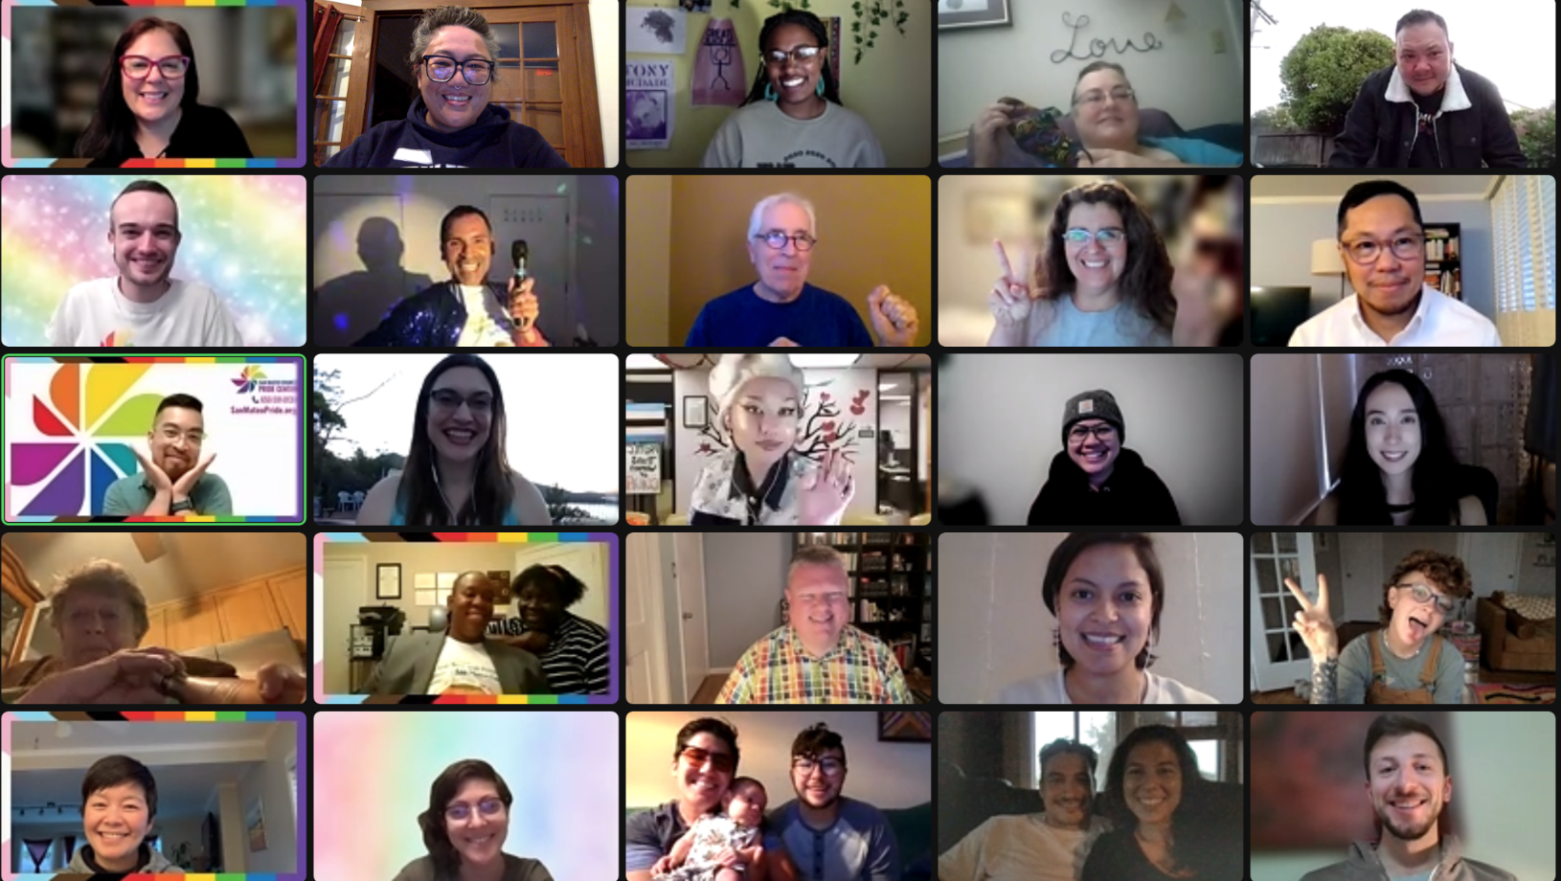

The Pride Center opened on
June 1, 2017
Notes:
Located in San Mateo on 11th and El Camino. Close to San Mateo Central Park.

Slide 3
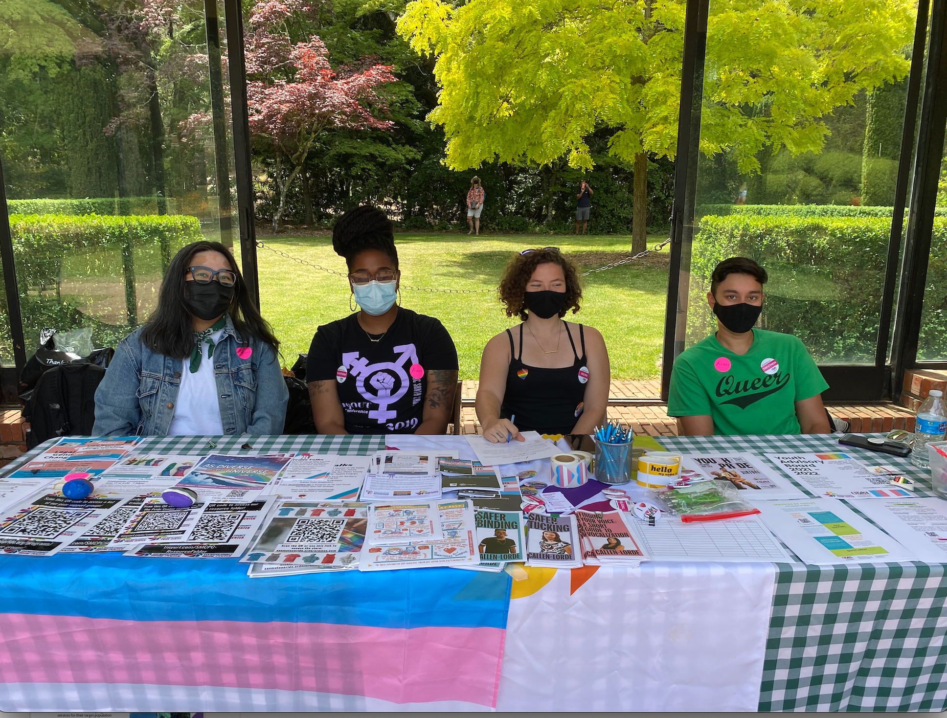
Who we are
The Pride Center is the first LGBTQ+ center in San Mateo County. We work in a collaboration model as a program of StarVista and working in partnership with:
  Peninsula Family Service (Older Adults)
  Outlet of Adolescent Counseling Services (Youth)
  We are excited to say that our staff reflect the community and clients we serve
  In addition to our official partners, we work closely with the following local organizations: SMC Pride Initiative, SMC LGBTQ+ Commission & CoastPride

Slide 4
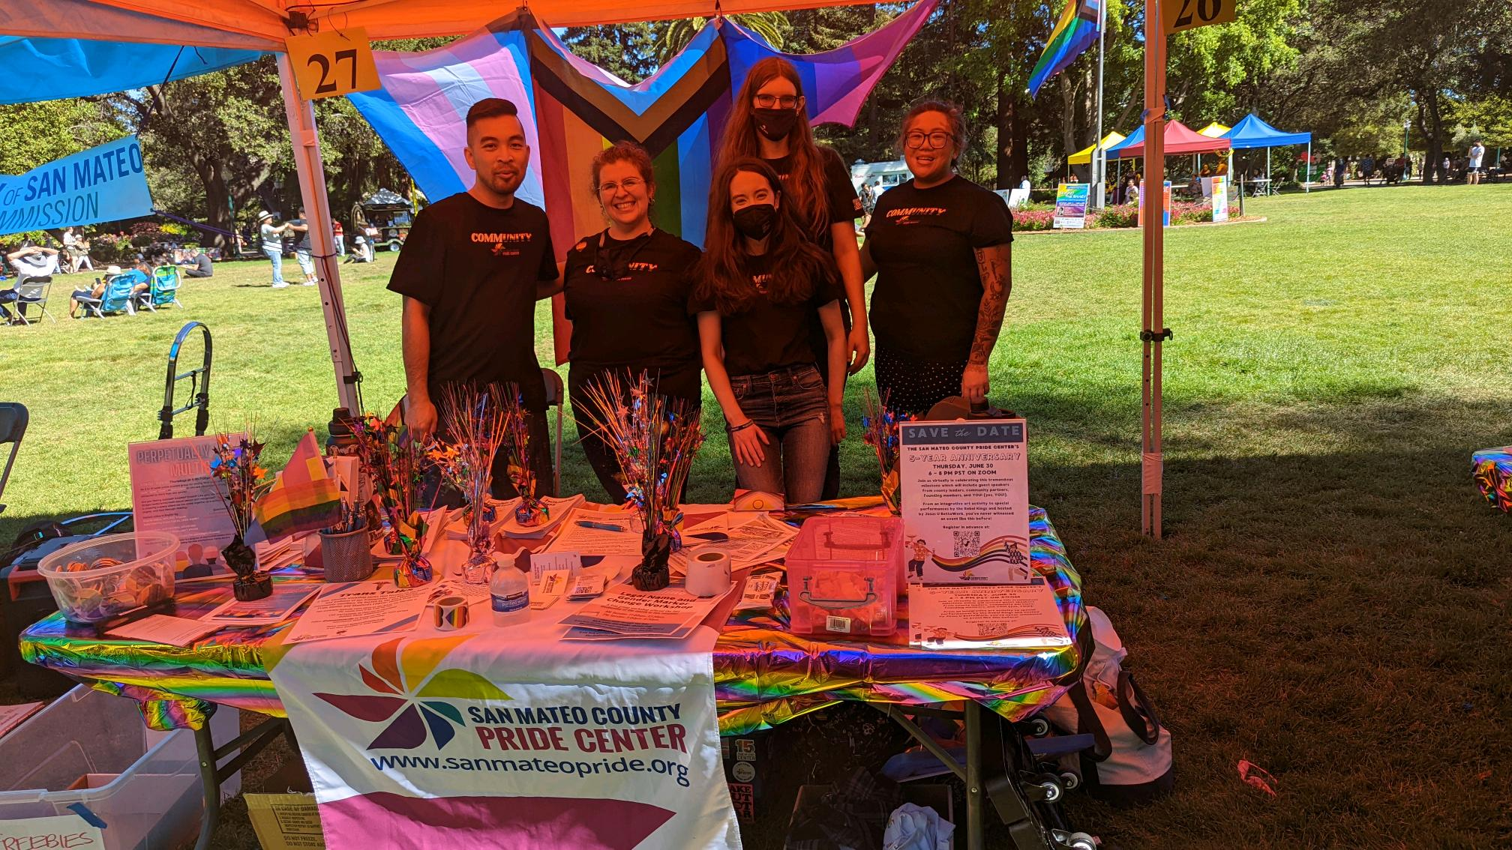
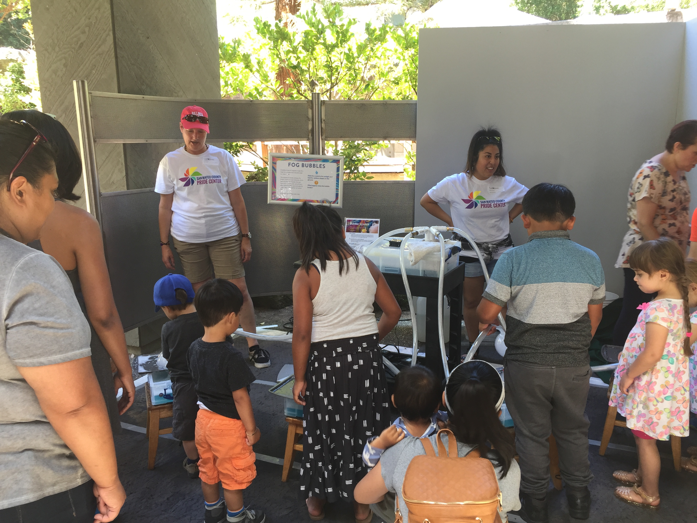
Who we are
Purpose and Outcomes
(Why do we do the work that we do?):
Serve LGBTQ+ community
Support wellness and recovery
Enhance collaboration of agencies that provide support
Increase access to mental health treatment and services
Improve mental health quality of life
Notes:
We are the first LGBTQ+ Community Center in San Mateo County. Here is a short summary of our purpose and outcomes.

Slide 5


Mission and Vision
The mission of the San Mateo County Pride Center is to create a welcoming, safe, inclusive, and affirming community climate that fosters personal growth, health, and opportunities to thrive for individuals of all ages, sexual orientations, and gender identities through education, counseling, advocacy and support.
The vision of the San Mateo County Pride Center is to create an innovative, respectful, and equitable community of all ages, ethnicities, cultures, sexual orientations, and gender identities that supports complete inclusion, is free of discrimination, strives for knowledge, challenges barriers, and seeks to empower agents of social change.

Slide 6
Our Core Values
Cultural Humility: Coined by doctors' Melanie Tervalon and Jann Murray-Garcia (1998) to address health disparities and institutional inequities. Practicing cultural humility requires bravery, empathy and respect.
Empowerment: We empower the LGBTQ+ community through the collaborations we build and grow through our clients. We provide a safe space where people have a sense of hope in their lives.
Anti-Oppression: Through education, peer groups, and community building opportunities, we hope to build an alternative to the disempowering and harmful systems of power that lead to physical harm, imprisonment, homelessness, poverty and mental/emotional unwellness.
Growth: Through continuous effort and struggle we value the flexibility to change and grow with our community. Our measurements of growth are not linear.
Play and Creativity: We strive to incorporate creativity in each of these areas as much as possible in order to better integrate creativity within our abundance of services. Creativity to the Pride Center means developing programs that reflect our desire to create a community that fosters positive relationships.
Notes:
Client and community centered.
Intersectionality is critical and intertwined with our values.
Always looking to improve ourselves, others, and our programs and services.
Queers ARE creative. We’ve had to be. We are resilient by design.

Slide 7





Clinical Services
Community Space
Resource Hub
Virtual Programs and Services
Computer Lab
LGBTQ+ Library
Web-based Media Center
Resource Database and Service Referrals
Food Pantry, Clothing, Gender Affirming Supplies
Individual, Family, and Partner Counseling (MediCal and Sliding Scale)
Peer Groups
Case Management
Legal Name and Gender Change Workshop
Training, Education, and Consultation
Intergenerational Community Events
Social, Cultural, and Art Events
Gathering Space for LGBTQ+ Community Groups

Slide 8
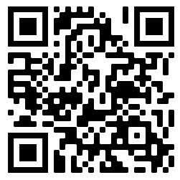
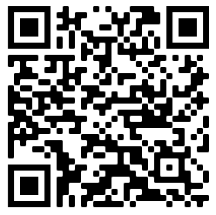
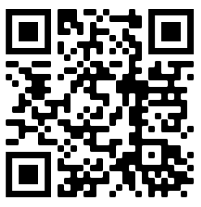
Community Space
Clinical
Services
Resource
Hub
Virtual Programs and Services
Scan the QR code
or use this link:
sanmateopride.org/
resources/trainings
to access information about training, education & consultation
Scan the QR code
or use this link:
sanmateopride.org/programs/mental-health-services/
to access information about clinical services.
Scan the QR code to access or use this link:
sanmateopride.org/
resources/
to access our resources!

Slide 9

Virtual Services Available:
Clinical Therapy Services: Sliding scale and MediCal payments accepted. We will work with the client to the best of our ability.
Case Management: Clients have the opportunity to work one-on-one with our health equity coordinator & lead case manager to get support with housing, jobs, medical paperwork, etc.
Monthly Name and Gender Marker workshop: community members can receive support with changing their name and gender marker on their legal documents (held on the last Wednesday of the month).
*Virtual services open to all residents of California with priority to San Mateo County
Notes:
If available, everyone is welcome. We know not everyone has services available to them.
If resources are limited, priority is to San Mateo County.

Slide 10
Virtual Services Available (continued):
Trainings are now available online and can be facilitated between 1.5 - 2 hours depending on the audience’s needs. (SOGIE 101 & 201, Trans 101, Pronouns 101)
Peer support groups that focus on everything from wellness to identity-based support groups, for everyone in our community from youth (10-18) to Older Adult (50+) and everyone in between!
Social and cultural events- events include a monthly book club, special programming events, exercise programs, & more!
*Trainings, peer support groups and social/cultural events are open to all community members
Notes:
If available, everyone is welcome to attend trainings, peer support groups and social/cultural events. We know not everyone has services available to them.
If resources are limited, priority is to San Mateo County.

Slide 11
Clinical Services:
The San Mateo County Pride Center provides high quality, LGBTQ+ affirming mental health services to community members living throughout San Mateo County. Mental wellbeing services include individual therapy, relationship therapy, family therapy, group therapy, and case management. Our work is strength-based, trauma-informed, engaging both natural supports and the whole family whenever possible.
If you have Medi-Cal, please call the ACCESS line to request therapy services at the San Mateo County Pride Center: (800) 686-0101, TDD: (800) 943-2833
        For more information please see this link:
        sanmateopride.org/programs/mental-health-services/
Notes:
Clinical services are open to residents of California

Slide 12

Trainings:
        SOGIE 101- An introduction to Sexual Orientation and Gender Identity/Expression terminology, Cultural Humility, and Best Practices to foster safe environments for the LGBTQ+ community.
        SOGIE 201- For folks who have taken our SOGIE 101 but are interested in breaking down Queer theory, colonization, and white supremacy as it related to the LGBTQ+ community.
        Trans 101- An in-depth training on relevant social and health issues impacting the trans community and ways to support trans folks in every setting.
        Pronouns 101- A training touching on the importance of using correct pronouns, how to ask someone's pronouns, and interactive practice on using gender neutral pronouns.
        * Content can be tailored, adapted, and developed upon request!
Notes:
If available, everyone is welcome. We know not everyone has services available to them.
If resources are limited, priority is to San Mateo County.

Slide 13
Peer Groups:
  QTBIPOC Group- Weekly group for LGBTQ+ folks of color ages 14-25.
  LGBTQ+ Youth Drop-in Group- Weekly drop-in group for youth ages 10-18.
  LGBTQ+ Book Club- Monthly book club for 18+ community members.
  Sharing and Caring- Weekly group for LGBTQ+ Women 55+.
  Gay Men's group- Monthly space for Gay and Men Loving Men (MLM) folks aged 18+; folks 50+ strongly encouraged to join.
  Get APP-y workshop- Monthly workshop for folks aged 50+ in need of support with technology (iphones, androids, etc).
*Virtual peer support groups open to all with priority to
San Mateo County
Notes:
If available, everyone is welcome. We know not everyone has services available to them.
If resources are limited, priority is to San Mateo County.

Slide 14
Peer Groups (continued):
  Polyamory Peer Power- Monthly discussion group for polyamorous, open, poly-curious, etc. Open to anyone aged 18+; folks 50+ strongly encouraged to join.
  Queer Women's Group- Monthly social space for all women identifying folks who are 18+.
  Trans Peer Support Group- Monthly support group for all trans, GNC, and non-binary community members aged 18+
  LGBTQ+ Parent Group – Monthly support group for parents to share space, share tips, and get support for members aged 18+.
  For more information about our peer support groups, check out our website:
  https://sanmateopride.org/programs/peer-groups/
*Virtual peer support groups open to all with priority to San Mateo County

Slide 15
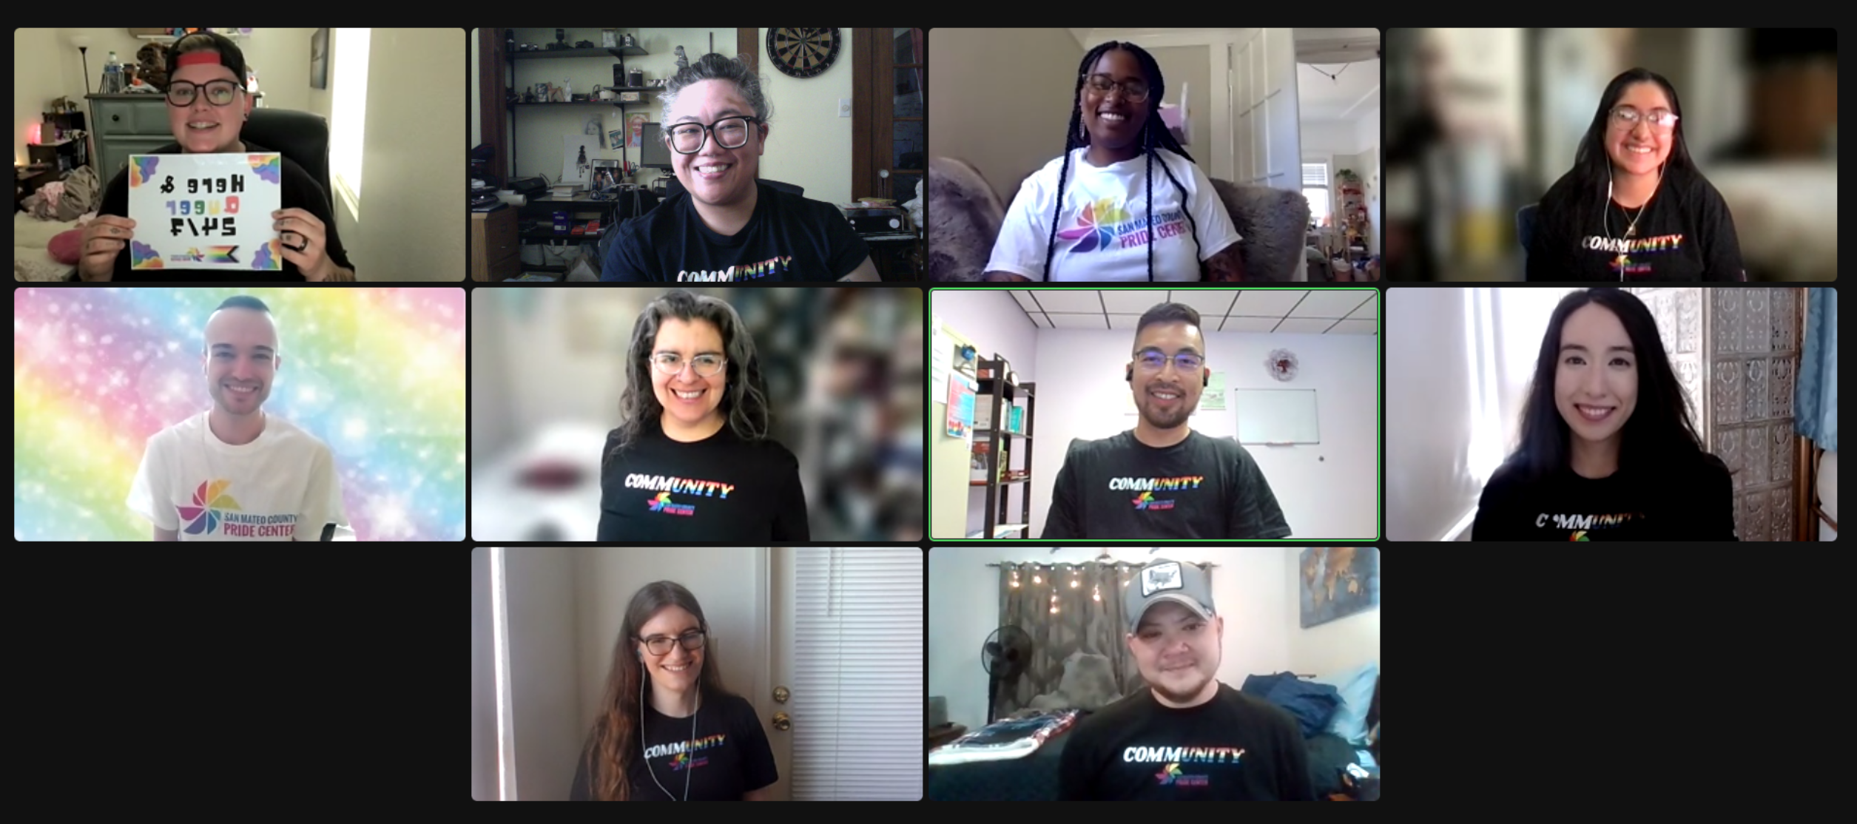
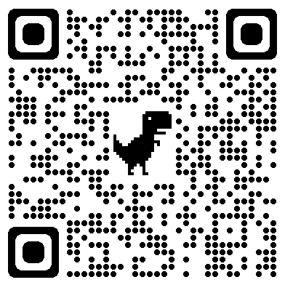
Looking for a way to support the Pride Center?
Spread the word about our programs and special events. All of our public-facing, specialized trainings, peer support groups and community events are free!
Consider sporting some of our merch with updated designs! Look super great while supporting your local Pride Center, supporting a POC artist and sharing visibility while out in the community? Yes, please!
Contribute to our monthly donor campaign!
Did you know you can provide support to our LGBTQ+ community members through an ongoing donation of as little as $5 a month?
Volunteer with the Pride Center! There are a variety of different ways you can contribute your skills and talents!
​
Information about supporting the Pride Center in these ways and more can be found on our website
sanmateopride.org

Slide 16
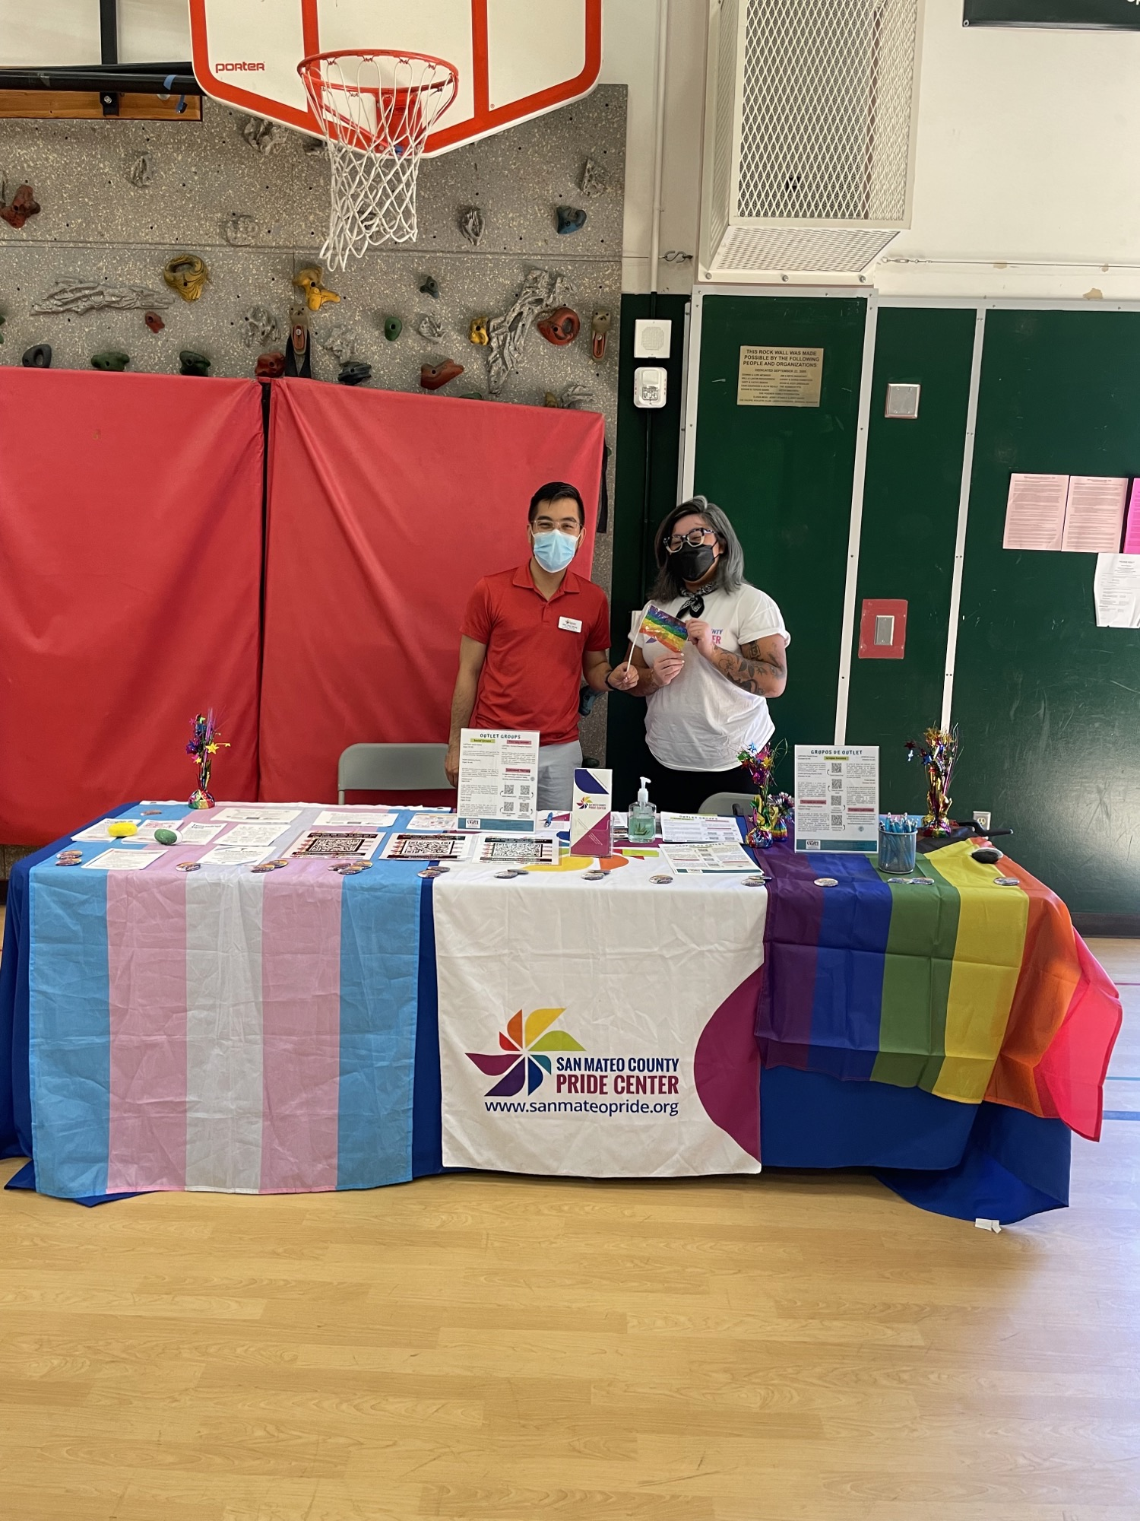

Other opportunities to work with the Pride Center:
If you are hosting an outreach event, please feel free to contact us! We have tabled at a variety of outreach events for a variety of communities and organizations and can tailor our resources and marketing materials to match your demographics.
Consider joining the Community Advisory Board (CAB), an group of specialized volunteers who work closely with the Pride Center. CAB projects have included: supporting with the Pride Center's 5-Year anniversary celebration, Queer Adult Prom and Winter Crafting Space.
Reach out to us if you would like a specialized training! We will meet you where you are and work with you to create a training that will support your team.

Slide 17
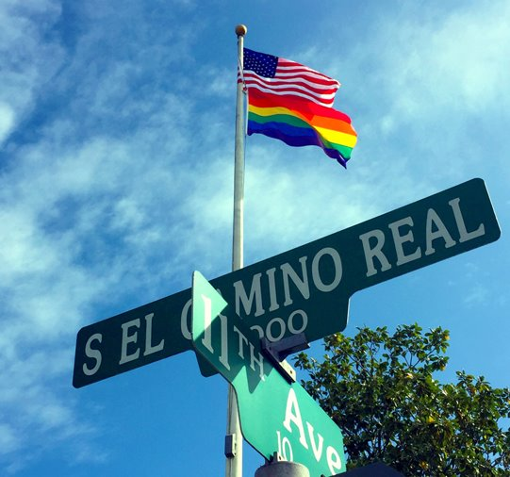
Come Visit Us:
We proudly offer our programs and services in person, virtual, and hybrid.
Our goal remains to be as inclusive, welcoming, and accessible as possible.
1021 S. El Camino Real
San Mateo, CA 94402
For questions about our programs and services or to schedule an on-site visit, please reach out to Francisco.Sapp@sanmateopride.org for information.
info@sanmateopride.org
650-591-0133
To sign up for our mailing list, please use this link: tinyurl.com/smcpc-newsletter
sanmateopride.org

Slide 18
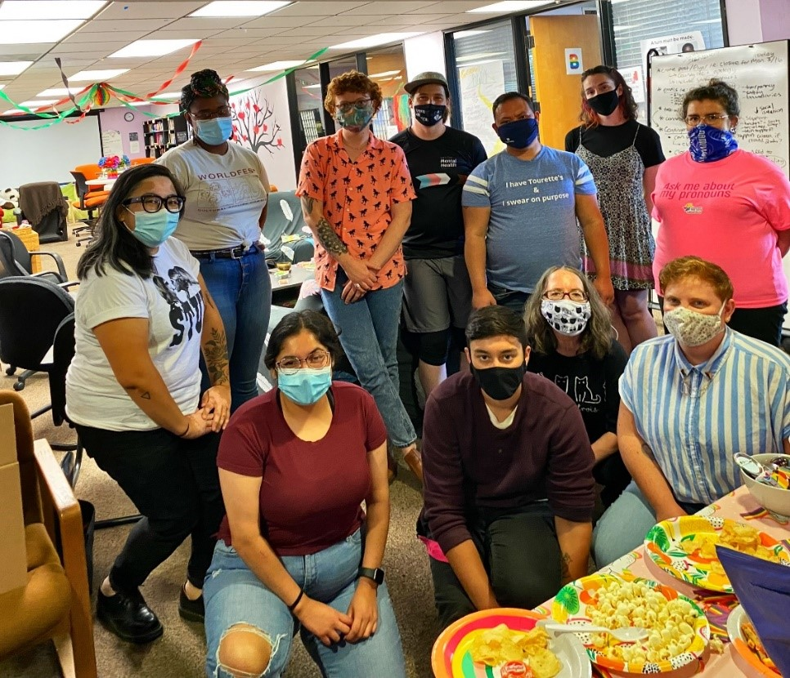
Questions?
Frankie Sapp (he/him)
Program Director
E: francisco.sapp@sanmateopride.org
C: 650.579.5441

Slide 19
Welcome Home
sanmateopride.org
Notes:
Social connection, physical distance.

